Slide 1
Prospecting for Good Mid- Cap Stocks Through Stock Screeners
MicNova Meeting December 15, 2016
Educational Presentation

Slide 2
Stock Screening Sources and Criteria
Purposes:
To Identify Mid-Cap Stocks for Further Study/Investing
To Demonstrate Some Stock Screening Sources
Screening Sources
Better Investing
Manifest Investing
Value Line Stock Screener (used through FFC Library)
Stock Rover
Criteria
Mid-cap size company (Per Investopedia.com: Market Cap $2 B-$10 B)
Projected EPS and Sales largely >10% year
Financial Strength => C (Note: ratings vary from different screening sources)

Slide 3
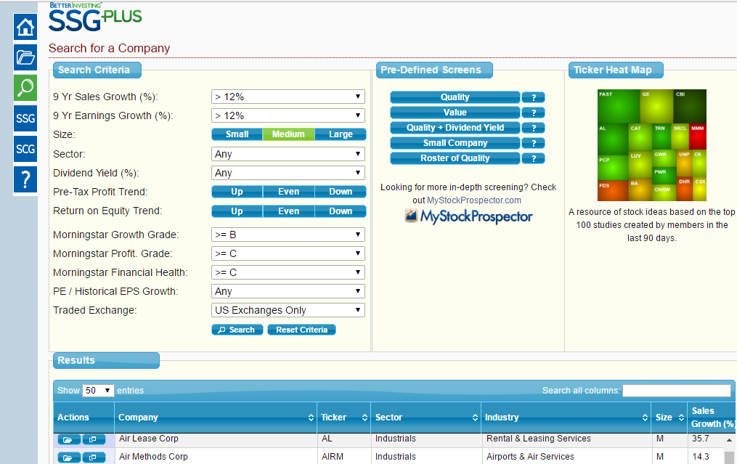
Better Investing Criteria/ Screen for Mid-Cap Companies
1
2
3

Slide 4
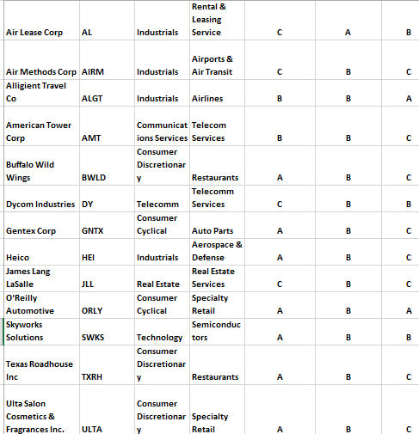
Better Investing Mid-Cap Stock Screen Results =14+ (some we own, some mentioned): Morningstar (MS) Ratings
1
2
3
4
5
6
7
8
9
10
11
12
13
14 +
United Therapeutics, Tractor Supply Co, etc..

Slide 5
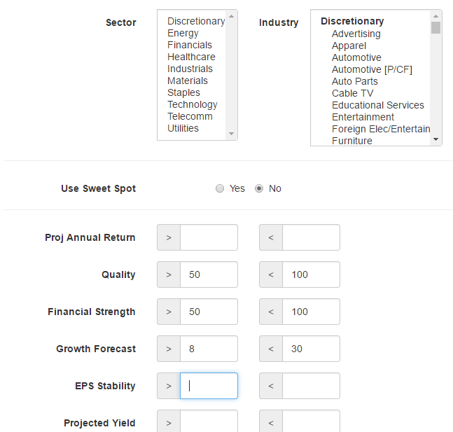
Manifest Investing Stock Screening (No criteria for size)
Note: For “Any” Sector/Industry,
Do not select from Sector or
Industry listings.

Slide 6
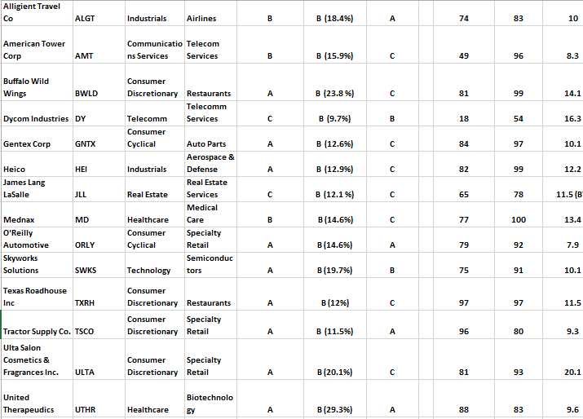
Differences in Better Investing vs. Manifest Investing Ratings
Book Value

Slide 8
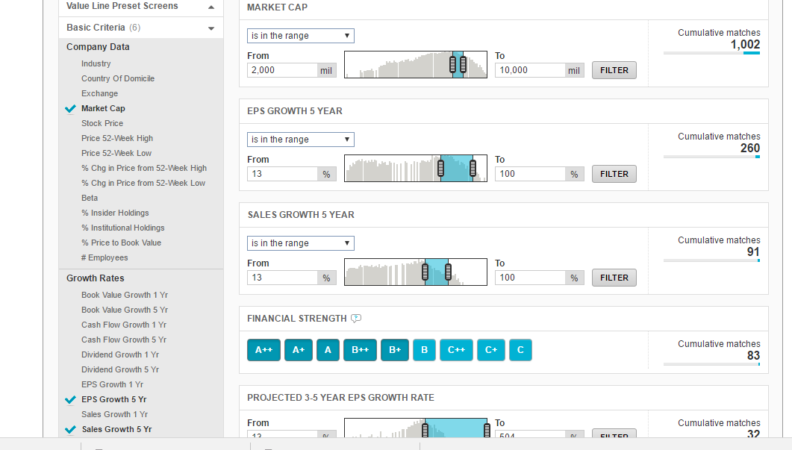
Value Line Criteria for Mid-Cap Co Screen:

Slide 9
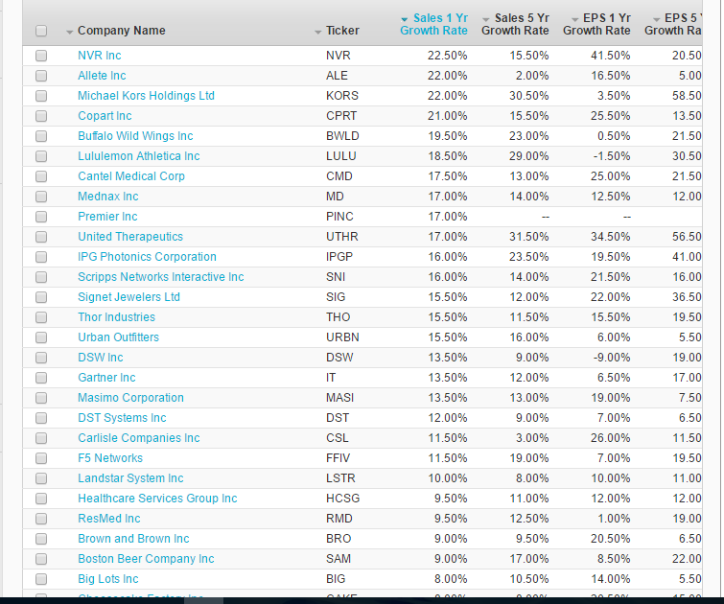
Value
Line
Stock
Screening
Results

Slide 10
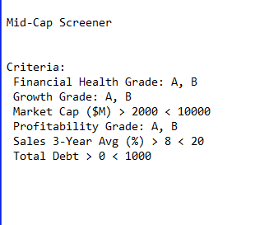
Stock Rover Basic Mid-Cap Screening Criteria

Slide 11
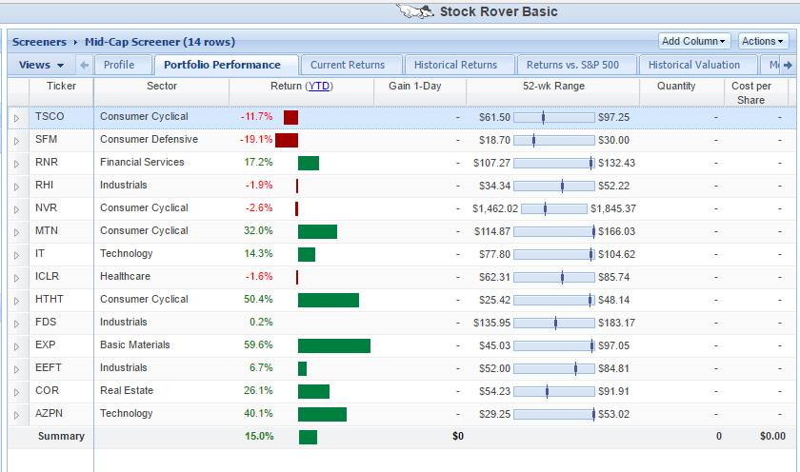

Slide 12
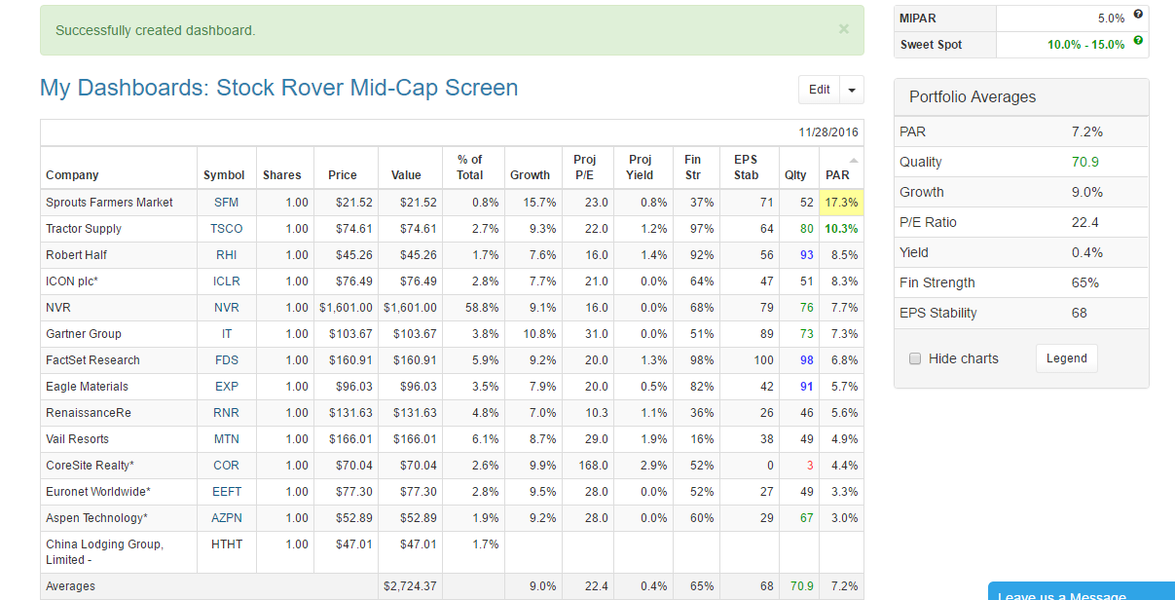

Slide 13
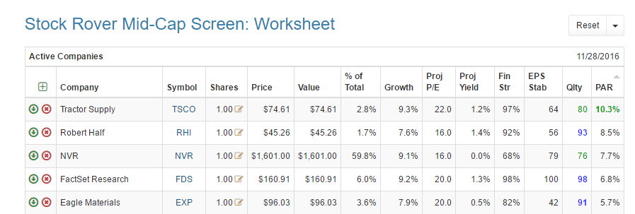

Slide 14
Conclusions (from Mid-Cap Stock Screeners)
Different Sites Provide Different Screens, and Some Rating Differences
From These Sites: Some Attractive Mid-Cap Stocks for Further Exploration are
Healthcare
United Therapeutics; (Maybe = Mednax Inc.)
Industrials/Telecomm/Telecomm Services
Allegiant Travel Co. (Airlines)
American Tower Co.
Dycom Industries
Heico
Technology
Skyworks Solutions; (Maybe = FactSet Research)
Consumer Discretionary
Buffalo Wild Wings
Texas Roadhouse
Ulta Salon Cosmetics & Fragrances
(Maybe14: O’Reilly Automotive; Scripps Network Interactive; Tractor Supply Co.)
Next Step: Industry/Style Stock Study Groups

