Slide 1
Limit Orders
Kathy Emmons
October 15, 2015

Slide 2
Purpose
Recap of Limit Order use by other BI Clubs
Source: emails on the Better Investing Discussion List
Dates: Sep 26-28, 2015
17 responses to question posted on Sep 26^{th—}
“Does your investing club ever use limit orders whey buying a stock?”
What this is NOT:
A primer on limit orders
A scientific analysis of BI club usage of limit orders
An analysis of WHY Clubs use limit orders
A when or how recommendation for our Model Club

Slide 3
Summary
Most respondents stated “yes” their club used limit orders
Some indicated that they ALWAYS used limit orders for both buys and sells
Several indicated that the buyer (club Treasurer) had discretion as to when to place the order, e.g. to avoid volatility in early morning trading.
Limit orders protected club from overnight events, e.g. Europe, Asia, etc., that caused market volatility
BI is about “Long term investing, not market timing”

Slide 4
Conclusion
Approach and discretion vary—club operating agreement should address the parameters
Biggest issue: Determining the limit order price – goes back to that Judgment thing!!
Sometimes a stock will be close to but not meet either the 3:1 U/D and 15% TR. Both Toolkit and SSGplus can display the price that will meet both criteria.
Should that be the minimum acceptable limit price?
Or what might be a reasonable way for the club to set a limit?

Slide 5
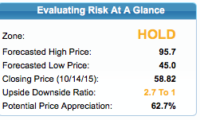
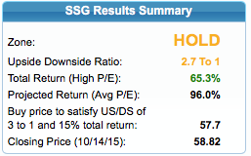
SBUX SSG Numbers
Trading on 9/18/15:
Open: 56.49
High: 57.63
Low: 56.28
Close: 56.84

Slide 6
Our Limit Orders
Date | Stock | Limit Price | Disposition
12/17/14 | PCP | $230 for $2,000 | 1/7/15 bought 9 shares @ $229.96
1/21/15 | PCP | 5 shares @ $195 | ???? Currently $231
3/18/15 | EOG | 15 Shares @ $87 | Expired. Currently $87, went as low as $68
9/17/15 | SBUX | 30 shares @ $ 50 | Currently $59.69 high of $60.09

