Slide 1
Debt to Equity & Debt to Capital
Jim Hurt
Director, Central Iowa Chapter

Slide 2
Two Related Terms
Terms on the SSG:
Debt to Equity.
Debt to Capitalization.
Closely related
Both measure how much debt.
Both appear in Toolkit 6.
Online SSG uses only Debt to Capitalization.
Notes:
A lot of talk about debt – Greece.

Slide 3
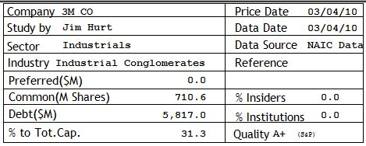
Where Do We See These?
Toolkit (all versions) Top of Side 1 of SSG
Notes:
This is Debt to Total Capitalization.

Slide 4
Where Do We See These?
Toolkit 6 Debt / Equity
Side 2, Section 2, Row 2C

Slide 5
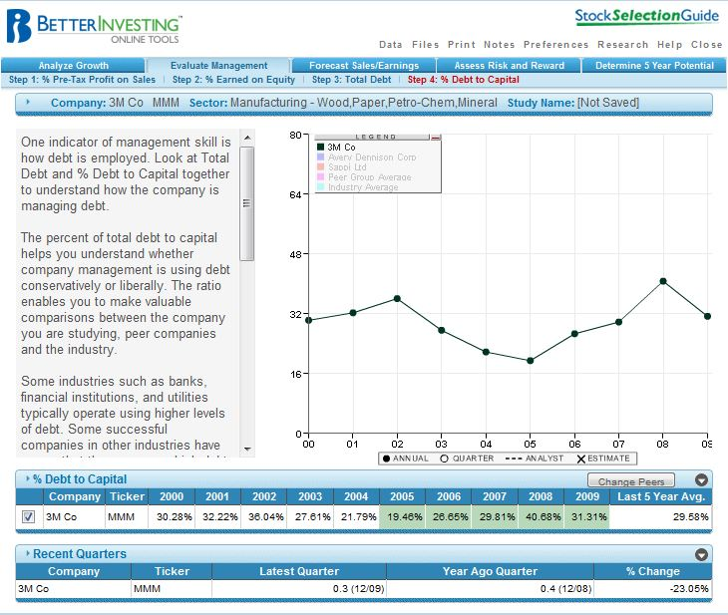
Online SSG Debt / Capital
Tab 2: Evaluate Management
Step 4: % Debt to Capital

Slide 6
Definition of Debt
Debt is what the company owes and has to pay interest on, such as:
Loans from banks.
Company bonds.
Preferred stock.
Short term debt has to be paid in the next twelve months.
Long term debt has to be paid later than the next twelve months.

Slide 7
Why Use Debt?
When the interest rate is lower than the rate of return on total capital, borrowing money is probably a good management decision. It will help a company grow.
It is important to know what the debt is being used for.

Slide 8
Definition of Equity
Assets are everything that the company owns at that moment.
Liabilities are everything the company owes at that moment.
Equity is assets minus liabilities.
Also called shareholder's equity.
Also called net worth.
Also called book value.
Also called retained earnings.

Slide 9
Debt to Equity Ratio
Compares debt to equity (debt/equity).
Indicates what proportion of equity and debt the company is using to finance its assets.
Toolkit 6 uses Long Term Debt and Shareholder’s Equity for row 2C.

Slide 10
High Debt to Equity
High debt to equity ratio: company is aggressive in financing its growth.
Can result in volatile earnings.
In hard economic times, too much debt can lead to bankruptcy.

Slide 11
How Much is Too Much Debt?
Varies for industries
--For manufacturing and retail companies, below 50%
--Financial companies run much higher (e.g. 900%)
Like to see D/E ratio even or down with time

Slide 12
What if D/E is Increasing?
Find out why! Read the annual report for this information.
Are the reasons valid?
Acquisition
New products
New factories
Increase productivity through automation, etc.

Slide 13
Definition of Capital
Funds a company can use for financing projects and other operations.
Capital equals Equity plus Debt.
Also called Total Capital.
Banks use a different definition.
Not to be confused with Market Capitalization!

Slide 14
Debt to Capital Ratio
Comparing debt to total capital.
Calculated by dividing debt by the sum of debt and equity.
Measures the fraction of all assets that have been paid for by borrowing.
Also called D/C or DC.

Slide 15
BI Advice on Debt to Capital
Companies should use some leverage, but not too much.
Want D/C to be below 33%.
Compare to – Remember, banks are special (D/C is around 90%).

Slide 16
Relationship Between D/E and D/C
D/E is Debt divided by Equity.
D/C is Debt divided by the sum of Equity and Debt.
D/E of 50% is the same debt as DC of 33.3%.

Slide 17
Questions?

