Slide 1
Visa 3rd Quarter Review
7-28-2023
MicNova

Slide 2
MicNova Portfolio
Visa average cost: $63.5177 (20 shares in 2014 and 10 shares in 2016)
Visa current cost: $237.56 @ 30 shares
Visa SSG 5yr Hi Price: $424 HOLD
Visa current share of portfolio: 5.5%
Visa Sector for Portfolio: Financial Services 11.7% (WAL and Visa)
Visa Industry for Portfolio: Transaction and Payment Processing Services 5.5%

Slide 3
Visa Inc. Reports Fiscal ThTrter023 Results
The 3rd quarter report was a BEAT ……

Slide 4
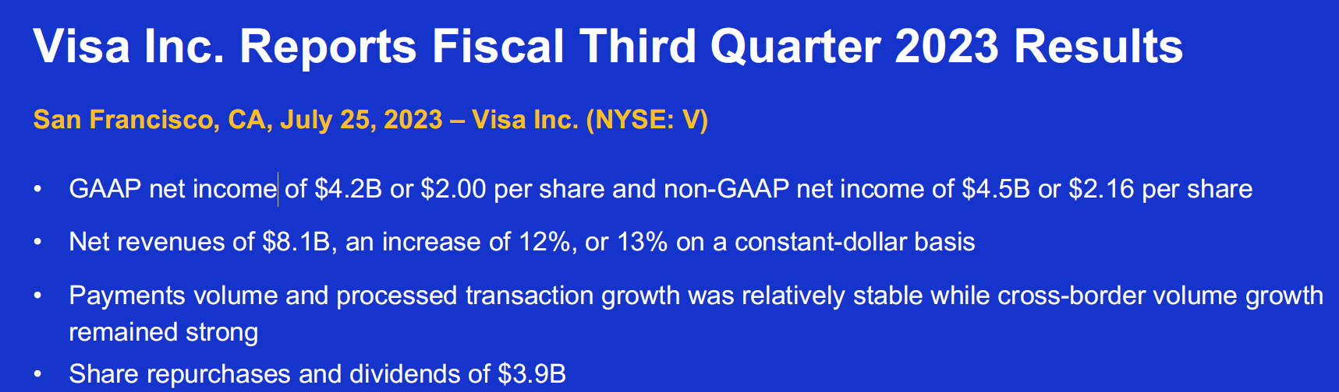
Visa Inc. Reports Fiscal Third Quarter 2023 Results

Slide 5
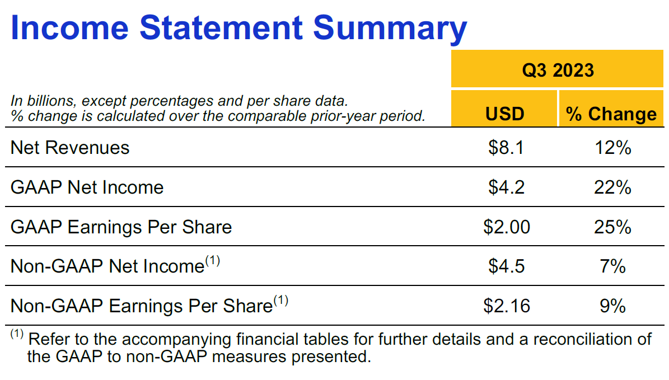
Visa Inc. Reports Fiscal Third Quarter 2023 Results

Slide 6
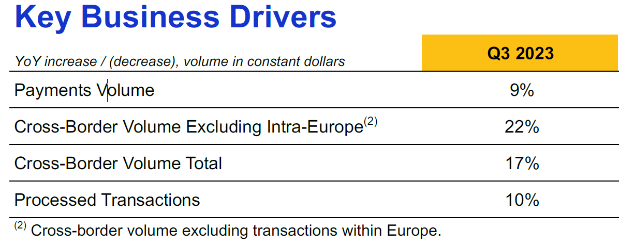
Visa Inc. Reports Fiscal Third Quarter 2023 Results

Slide 7
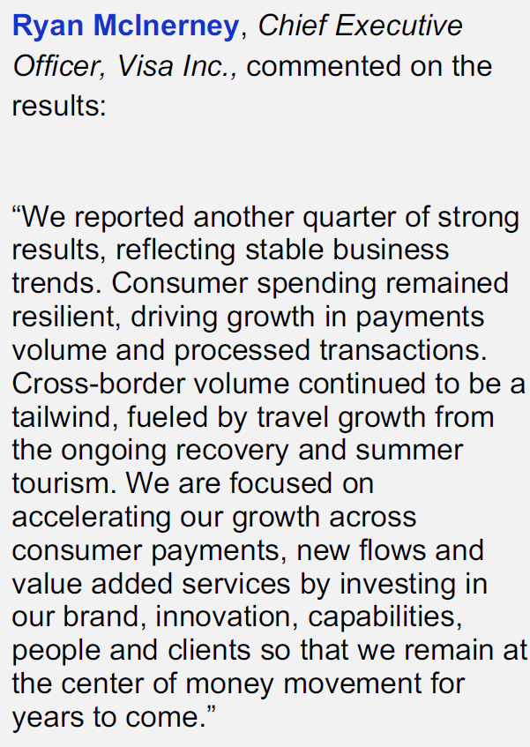
Visa Inc. Reports Fiscal Third Quarter 2023 Results

Slide 8
Adjusted SSG Slightly
Forecast will start from trend but use 2-year consensus estimate drawn out to 5 years, like before. Use high medium PE29 partially based on consensus.
This yields a hi forecast of $424 and a current HOLD

Slide 9
The Good

Slide 10
Proven management team
managing a nice moat!
"Visa announced that current CEO Alfred Kelly will step down and Ryan McInerney will take over at the
start of February. Kelly, who has been CEO since 2016, will assume the role of executive chairman at
that time. We have a generally favorable view of Kelly's tenure, although we believe the company's
wide moat is the dominant factor behind its strong performance. McInerney, who came to Visa from JP
Morgan, has served as president at Visa since 2013. We think Visa's decision to go with an
insider—and Kelly's continued presence as executive chairman—suggests that the company will
largely maintain its recent strategic course, and we see that as the right move"
..... MorningStar

Slide 11
Estimates support SSG
Estimates from VL:(8-1-23)
18mon $193-342
3-5yr $380-310. 3-5yr -- > pe28, EPS 13.5%, Revenues 11.5
Earnings Predictability 90
Estimates from CFRA:(7-29-23) BUY
Fair Value $244, 12 months $285
Estimates from Argus:(7-27-23) 12month BUY & 5year BUY
$274 12 months using PE28, 5yr EPS 20%
Estimates from Schwab:(7-28-23) Strongly Outperform
5yr EPS 14.3-14.8%
Estimates from RBC:(7-25-23) Outperform
$290 based on CY24 EPS of 10.35 and a PE28

Slide 12
A long runway
CFRA wrote:
“The major secular driver is the decline in cash and check transactions around the world. While a well-known trend, the remaining runway and implications are huge, in our opinion. Visa estimates there is still $18 trillion in payment volume done through cash and checks globally.”
“International growth will continue to be the major driver as non-cash transactions are estimated to grow at a compound annual growth rate of nearly 10% globally….”
“Besides the scale of its network, Visa’s greatest asset is its brand as Visa is seen as one of the safest and most reliable ways to make payments”
“We see continued low double-digit revenue growth or higher continuing on the growth of worldwide payments and assuming Visa maintains its market share”

Slide 13
A long runway
Argus wrote:
“Visa noted that only 14% of the $25 trillion in global spending in 2019 was in digital form, indicating a long runway for growth as payments shift to digital. In the U.S., the company said that cash accounted for 55% of transactions under $10, representing a significant opportunity as Visa expands frictionless payment capabilities and as merchants lower their minimum charge requirements.
RBC wrote:
“We believe V is a core long-term holding and an “indexed” way to play payments and benefit from three global secular trends:
1) continued share gains in global cash-to-digital conversion
2) capturing new payment flows via its network-of-networks strategy
3) increased utilization of value-added services”

Slide 14
Nice chart with possible trend channel
…Maybe

Slide 15
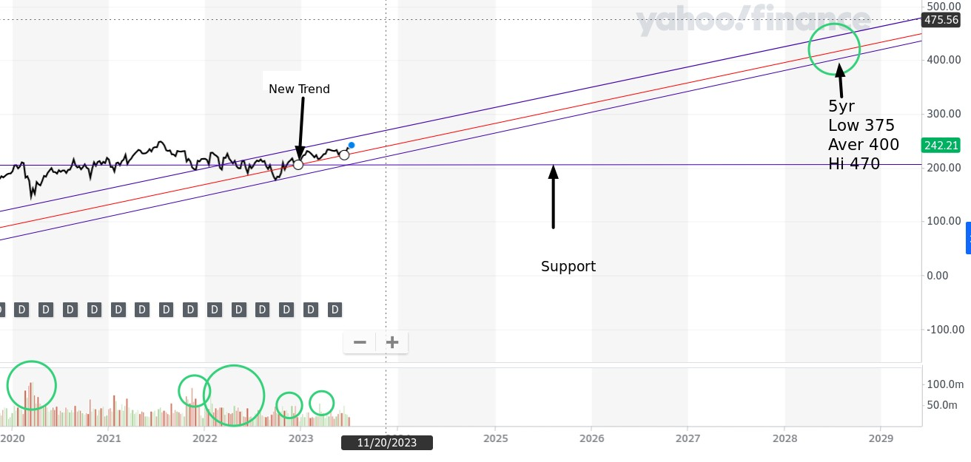
Nice chart

Slide 17
The BAD

Slide 18
Hard landing
and
COVID related!!
“We’re pleased to see Visa maintain strong growth in this area (cross boarder), but we expect growth to come down as volumes converge on the prepandemic trend. Further, a negative turn in the economy could put the recovery in travel at risk.”
“The cross-border rebound has been a material tailwind for Visa, and that tailwind would eventually diminish.”
“On the positive side, the reopening of China's borders could be a significant positive on this front”
…… MorningStar (7/2023)
Estimates from MorningStar:(8-1-23) Fair value $241 <--(2023 PE29) 3 stars

Slide 19
So, should we keep it?

Slide 20
YES
……… Patrick

